Slide 1
Semantic Network
&
Knowledge Graph
Logic for Artificial Intelligence
Yi Zhou

Slide 2
  Content
    Semantic network
    Frame system
    Knowledge graph
    Knowledge base construction
    Knowledge base completion
    Conclusion

Slide 3
  Content
    Semantic network
    Frame system
    Knowledge graph
    Knowledge base construction
    Knowledge base completion
    Conclusion

Slide 4
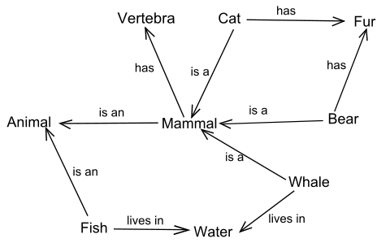
Semantic Network
Node: Concept Edge: Relationship

Slide 5

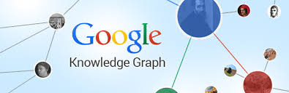

Semantic Networks
ConceptNet5

Slide 6
  Content
    Semantic network
    Frame system
    Knowledge graph
    Knowledge base construction
    Knowledge base completion
    Conclusion

Slide 7
Frame System
Frame
  Facts or Data
  Values (called facets)
  Procedures
        IF-NEEDED : deferred evaluation
        IF-ADDED : updates linked information
  Default Values
        For Data
        For Procedures
  Other Frames or Subframes

Slide 8
Frame System - Example
Slot | Value | Type
ALEX | _ | (This Frame)
NAME | Alex | (key value)
ISA | Boy | (parent frame)
SEX | Male | (inheritance value)
AGE | IF-NEEDED: Subtract(current,BIRTHDATE); | (procedural attachment)
HOME | 100 Main St. | (instance value)
BIRTHDATE | 8/4/2000 | (instance value)
FAVORITE_FOOD | Spaghetti | (instance value)
CLIMBS | Trees | (instance value)
BODY_TYPE | Wiry | (instance value)
NUM_LEGS | 1 | (exception)

Slide 9
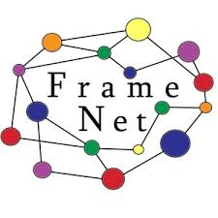

Frame Systems

Slide 10
  Content
    Semantic network
    Frame system
    Knowledge graph
    Knowledge base construction
    Knowledge base completion
    Conclusion

Slide 11
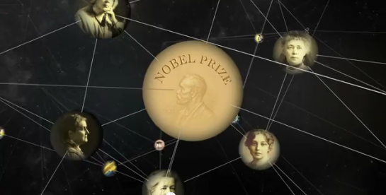
Google Knowledge Graph
“A huge knowledge graph of interconnected entities and their attributes”.
Amit Singhal, Senior Vice President at Google
“A knowledge base used by Google to enhance its search engine’s results with semantic-search information gathered from a wide variety of sources”
http://en.wikipedia.org/wiki/Knowledge_Graph

Slide 12
Sources
Based on information derived from many sources including Freebase, CIA World Factbook, Wikipedia
Contains 570 million objects and more than 18 billion facts about and relationships between these different objects

Slide 13
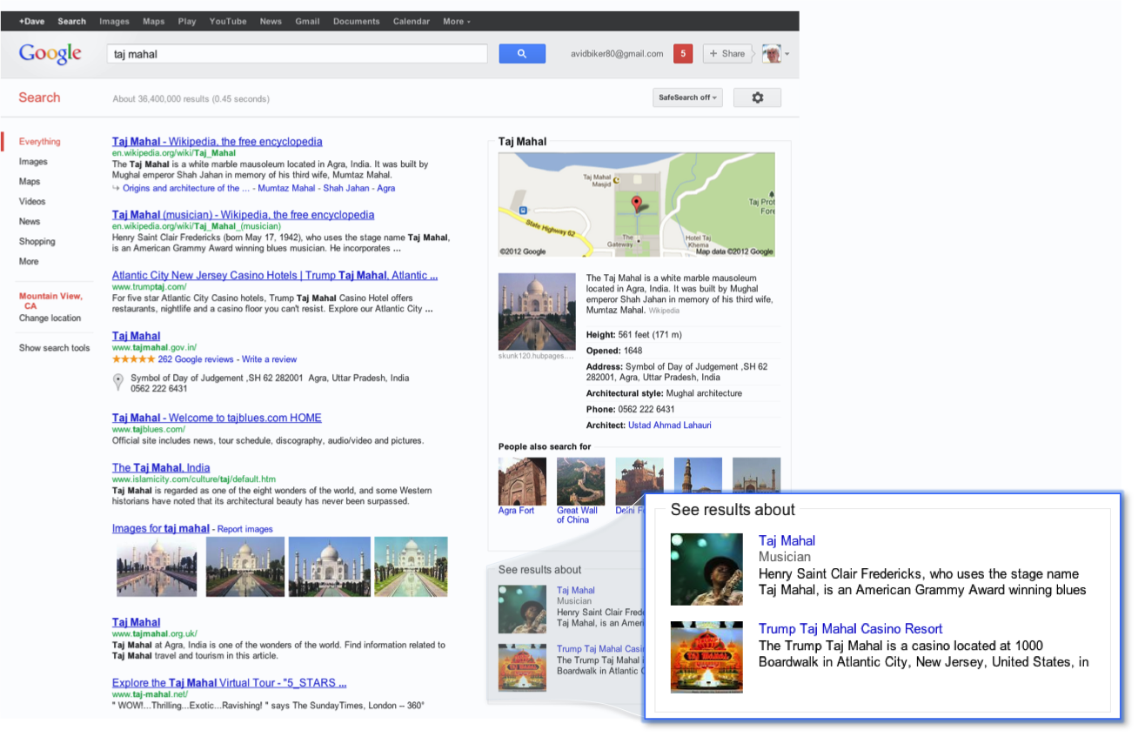
How to use
GKG enhances Google Search in three main ways:
Find the right thing
  deals with the ambiguity of the language

Slide 14
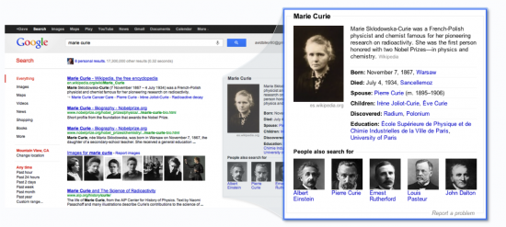
How to use
GKG enhances Google Search in three main ways:
Summaries
  summarize relevant content around that topic, including key facts about the entity

Slide 15
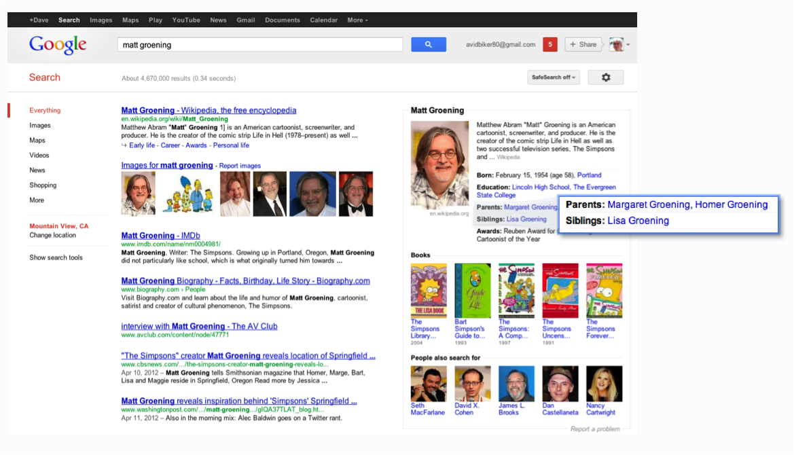
How to use
GKG enhances Google Search in three main ways:
Deeper and broader information
  reveal new facts
  anticipate what the next questions and provide the information beforehand (based on what other users asked before)

Slide 16
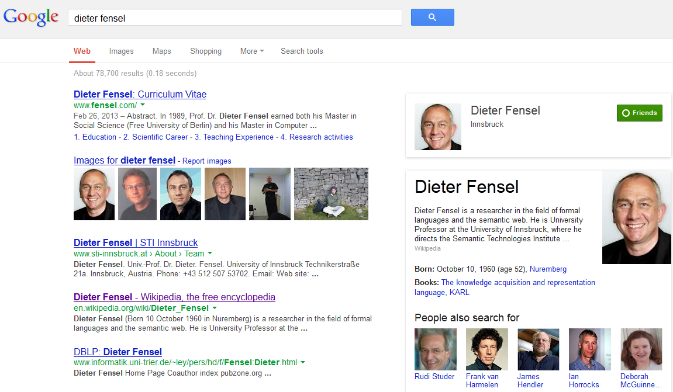
How it is used?
Search for a person, place, or thing
  Facts about entities are displayed in a knowledge box on the right side

Slide 17
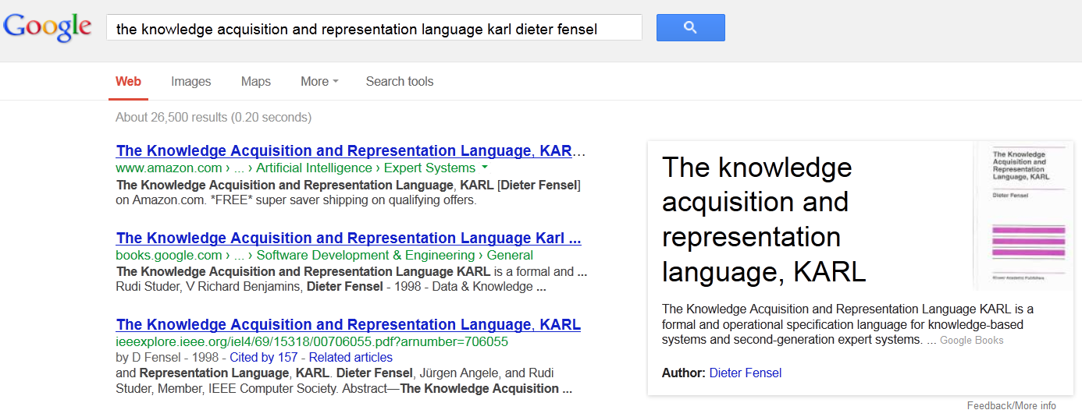
How it is used?
Explore your search

Slide 18
Data sources
CIA World Factbook
Freebase
Wikipedia
and many others …

Slide 19

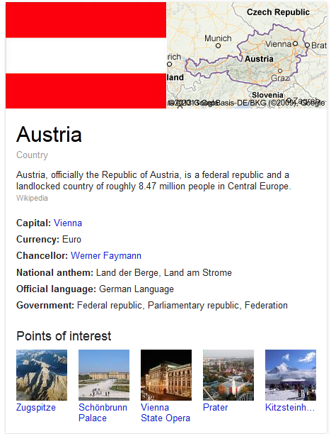
GKG and CIA World Factbook
CIA World Factbook is a reference resource produced by the Central Intelligence Agency of the United States with almanac-style information about the countries of the world.
GKG integrates information about geography, government, economy, etc. from CIA World Factbook

Slide 20

GKG and Freebase
Freebase is large collaborative knowledge base, developed by Metaweb and acquired by Google in 2010.
GKG uses UIDs directly from the Freebase; detective work of Andreas Thalhammer showing how to get from GKG UIDs to Freebased UIDs using base64 and gzip
Check the “Knowledge Graph links to Freebase” thread on w3c mailinglist http://lists.w3.org/Archives/Public/semantic-web/2012Jun/0028.html

Slide 21
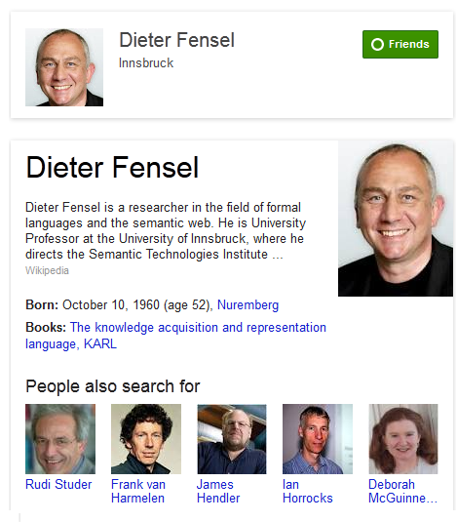
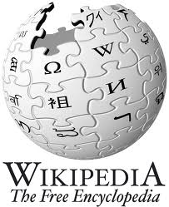
GKG and Wikipedia
For most search results first sentences come from Wikipedia

Slide 22
Other sources
GKG also considers the information Google retrieves from the volume of queries done by the users and the links those users have clicked on the results presented for those queries

Slide 23
GKG and other Google products
GKG is integrated with other Google products e.g. Google+

Slide 24
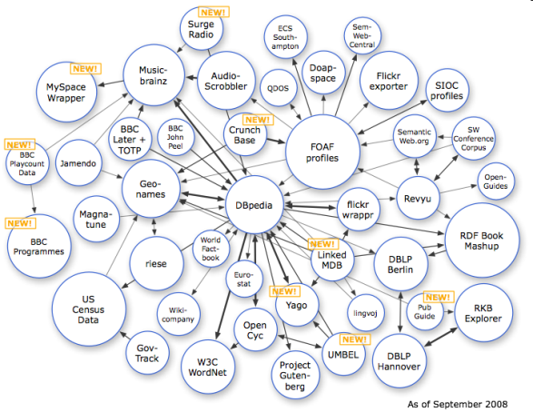

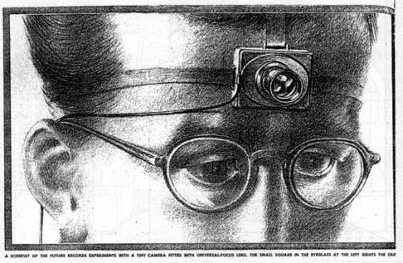
Web of Data
Web of Data
Semantic Web
Picture from [4]
?
Semantic
Annotations
Web
Hypermedia
Hypertext
“As We May Think”, 1945
Picture from http://www.theatlantic.com/doc/194507/bush

Slide 25
  Content
    Semantic network
    Frame system
    Knowledge graph
    Knowledge base construction
    Knowledge base completion
    Conclusion

Slide 26
Knowledge Base Construction
  Crowdsourcing from experts
  openCyc, snomed
  Crowdsourcing from non-experts
        Freebase, wikidata
  Interactive games
        conceptNet
  Automated construction from structured data
        data mining
  Automated construction from semi-structured data
        Google’s knowledge graph, DBpedia
  Automated construction from unstructured data
        Deepdive, openIE

Slide 27
Knowledge Bases
  OpenCYC, WordNet, FrameNet, ConceptNet, Verbnet, Freebase, Google knowledge graph/vault, BabelNet, YAGO, DBpedia, WikiData, Wiktionary, OMCS, WikiHow, ProBase/ConceptGraph, SNOMED… …

Slide 28
  Content
    Semantic network
    Frame system
    Knowledge graph
    Knowledge base construction
    Knowledge base completion
    Conclusion

Slide 29
Knowledge Base Completion
  Knowledge bases are far from complete
  Can machines automatically derive new knowledge in order to complete the knowledge base?

Slide 30
Distributed Representation
  Traditional representation
  Beijing = [0,0,0,0,0,1,0,0,0,0,0]
  China = [0,0,0,0,1,0,0,0,0,0,0]
  Sim(Beijing,China)=0
  Distributed representation
  Beijing = [0,0,0,1,0,1,0,0,1,0,0]
  China = [0,0,1,1,1,0,0,0,1,0,0]
  Sim(Beijing,China)=0.84

Slide 31
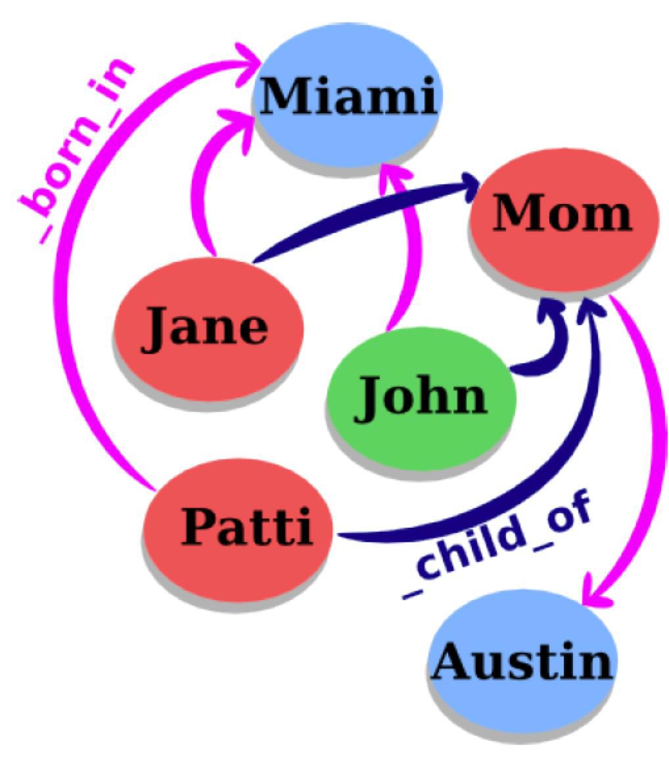
Head, Relation, Tail
Knowledge structured as graph
  –Eachnode=anentity
  –Eachedge=arelation
Fact: (head,relation,tail)
  –head=subjectentity
  –relation=relationtype
  –tail=objectentity
TypicalKGs
  –WordNet:LinguisticKG
  –Freebase:WorldKG

Slide 32
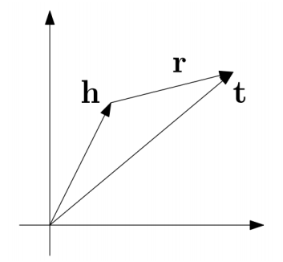
TransE
For each triple (head, relation, tail), relation as a translation from head to tail
Learning objective: h+r = t

Slide 33
  Content
    Semantic network
    Frame system
    Knowledge graph
    Knowledge base construction
    Knowledge base completion
    Conclusion

Slide 34
Conclusion
    Semantic network for representation
    Google’s knowledge graph
    Knowledge base construction for learning
    Knowledge base completion for reasoning

Slide 35

Thank you!

